Slide 1
Welcome to 6th Grade!
Mrs. Matherlee
6th Grade Science

Slide 2
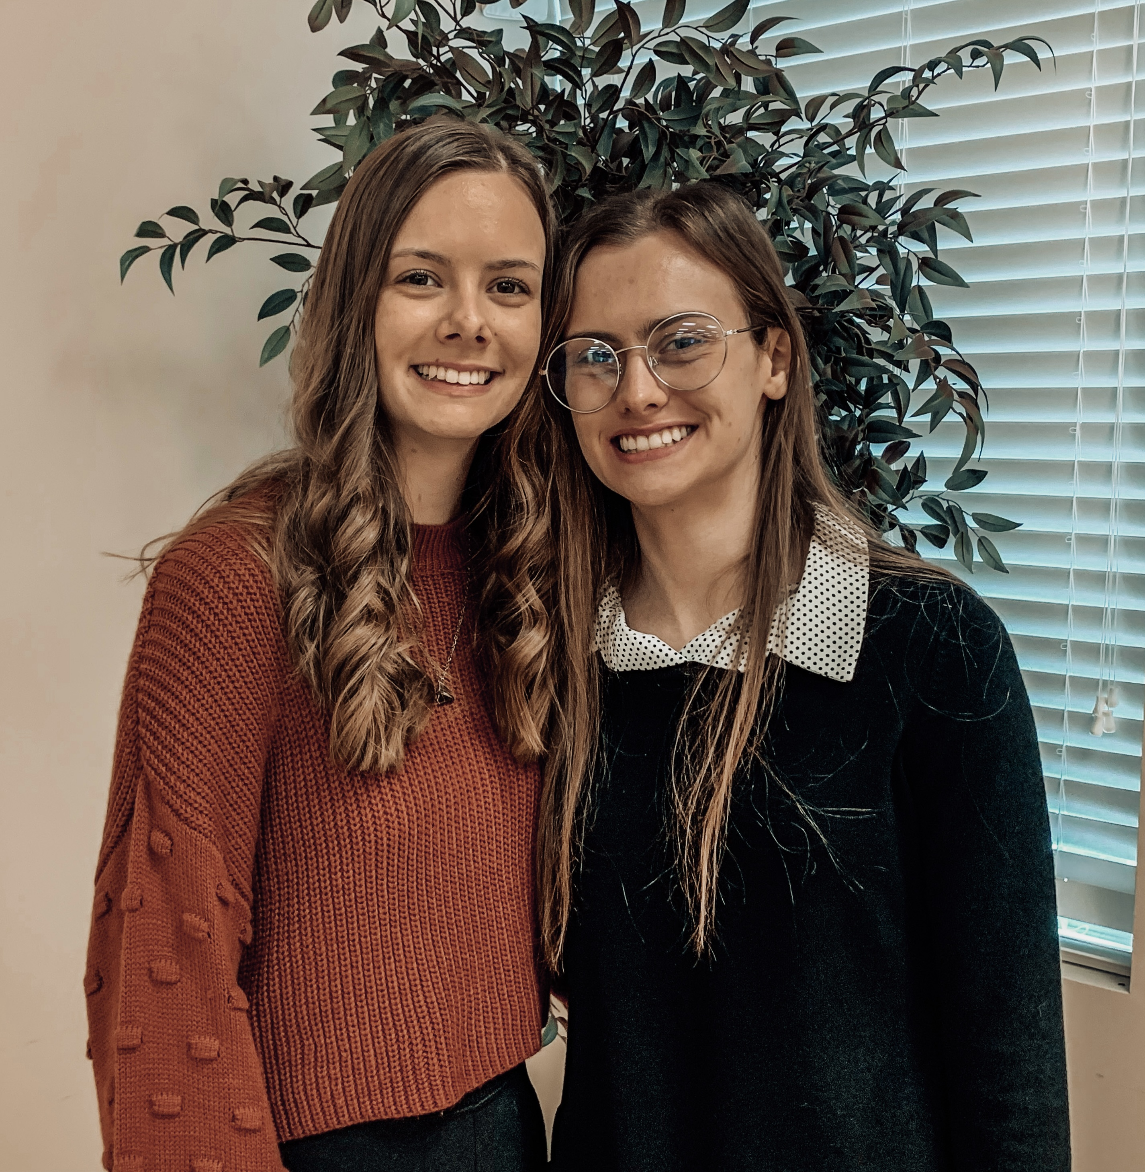
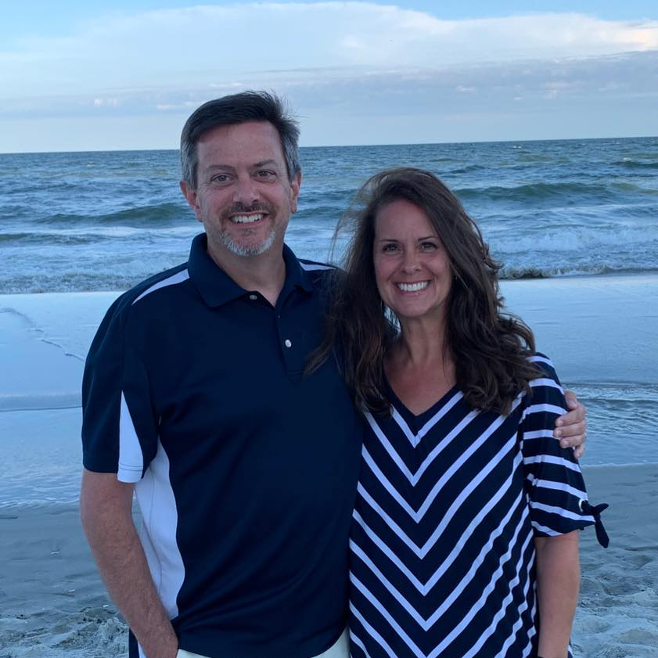
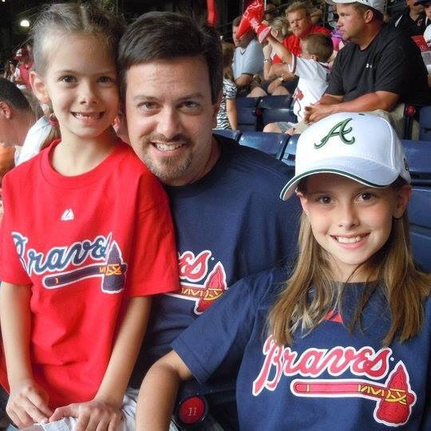
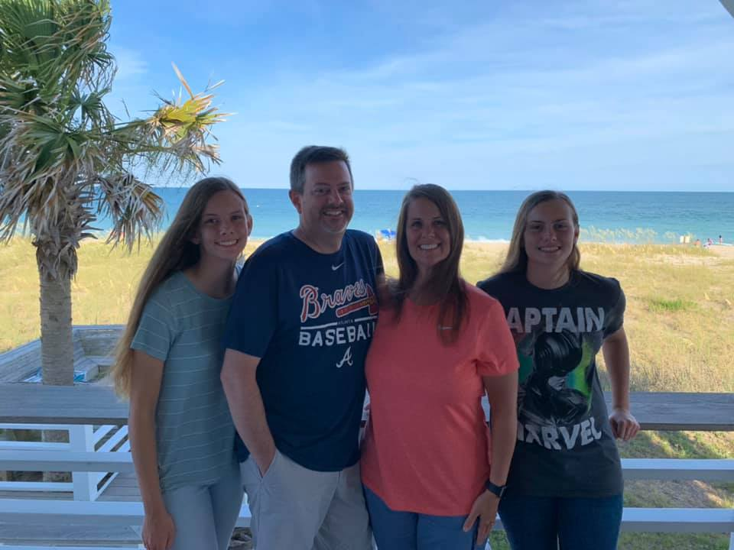
Mrs. Matherlee 6th Grade Science
Who is your science teacher?
We just celebrated 28 years!
(many years ago)
Ashley – 20
Emily – 23

Slide 3
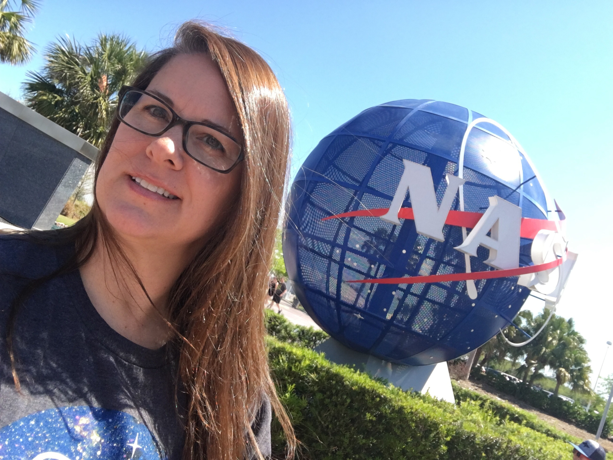
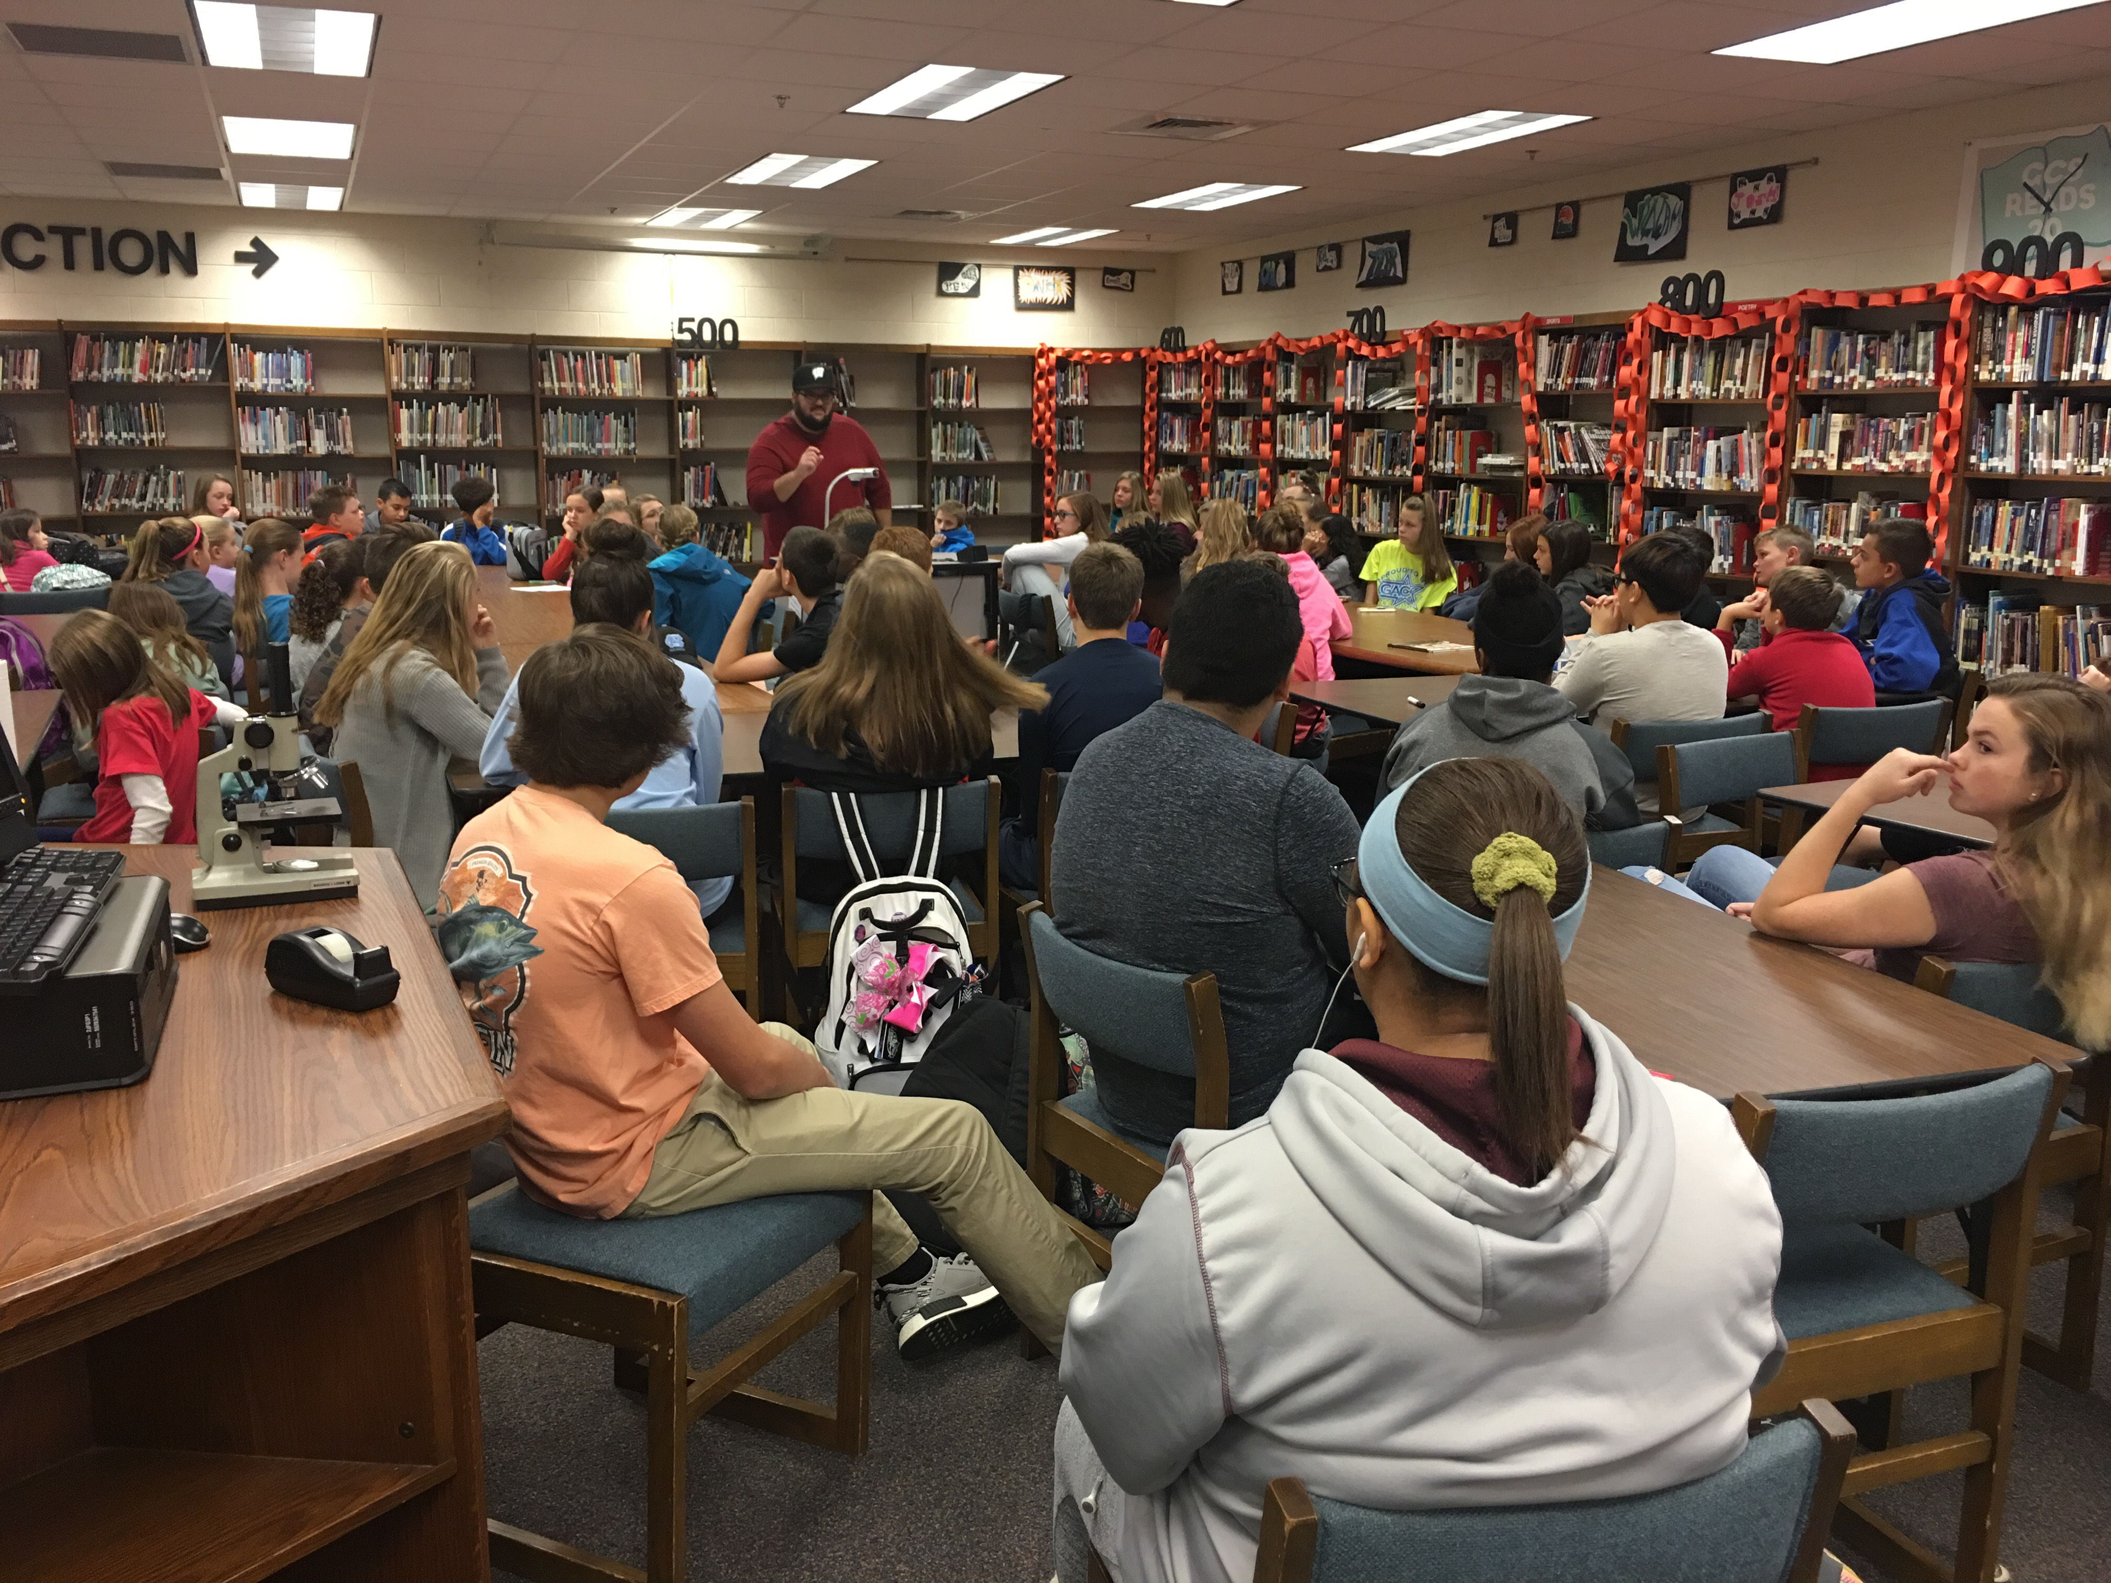
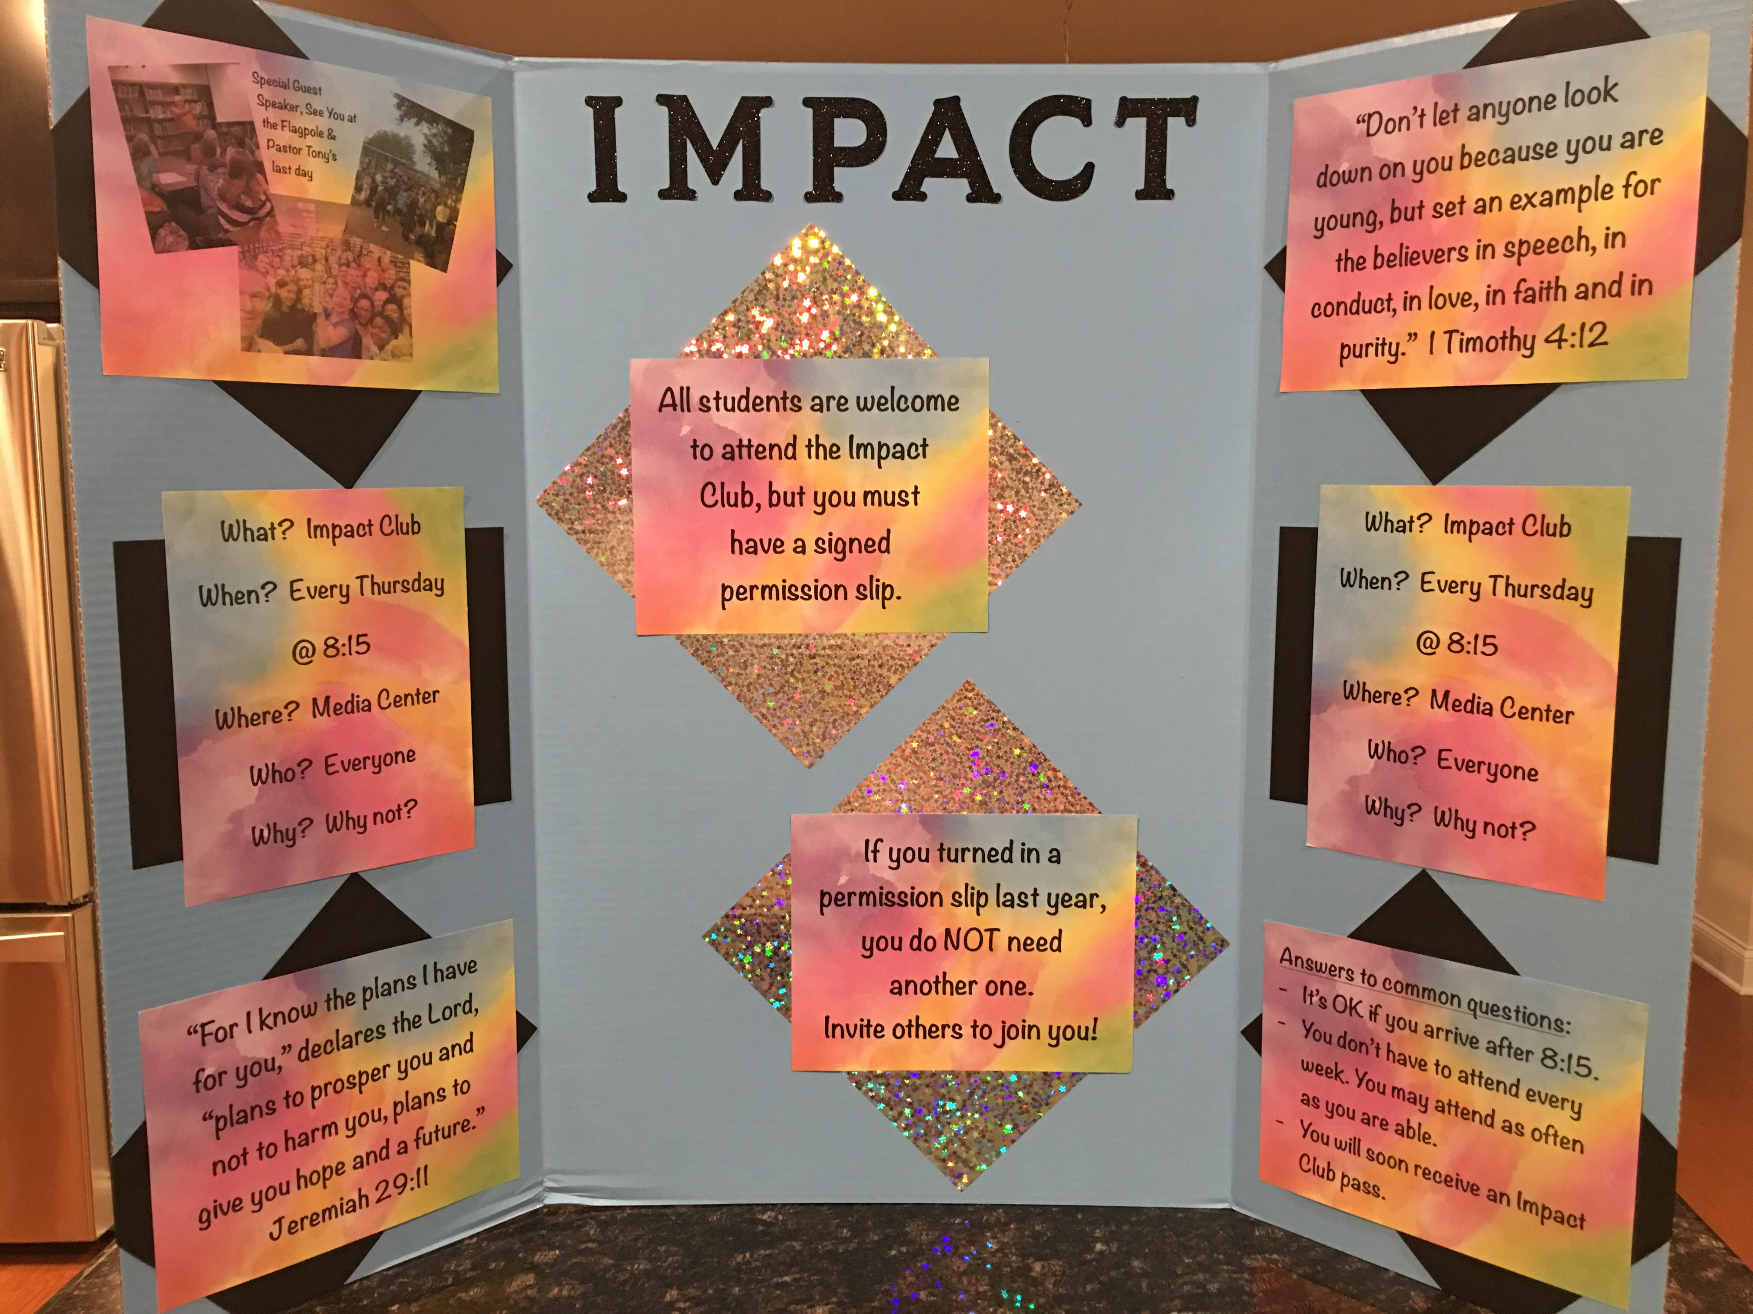
Mrs. Matherlee 6th Grade Science
Who is your science teacher?
I’ve spent many years coaching volleyball, basketball and Battle of the Books. Currently, I sponsor the Impact Club.
This is my 30th year teaching middle school, (26th year teaching 6th). I have experience in ELA, science and social studies.

Slide 4
Mrs. Matherlee 6th Grade Science
School Supplies
There is a main list of supplies for all teachers. Most of those items will be shared. Each class will give you a short list with a few items specific for that class.
If you brought supplies today, feel free to leave them in your HOMEROOM class as long as your NAME is written on them.
You are welcome to take pictures of these slides for helpful information.

Slide 5
Mrs. Matherlee 6th Grade Science
School Supplies
Students must have WIRED headphones / ear buds every day at school.
You are welcome to take pictures of these slides for helpful information.

Slide 6
Mrs. Matherlee 6th Grade Science
School Supplies
Please let us know if you need any assistance with obtaining school supplies.
THIS POWERPOINT IS LOCATED ON MY WEBSITE
UNDER “COURSE EXPECTATIONS”

Slide 7
Mrs. Matherlee 6th Grade Science
Communication with Teachers
If you need to contact me, please send an email to: matherl@gcsnc.com
Most teachers use “Remind” to communicate with parents/guardians. You will need to sign up with each core class. Information about this will be sent home. Students can sign up too.
You are welcome to take pictures of these slides for helpful information.

Slide 8
Mrs. Matherlee 6th Grade Science
Communication with Teachers
You are welcome to take pictures of these slides for helpful information.
Here’s how to sign up for “Remind”:
Send a text message to 81010.
For Mrs. Matherlee’s Core 1 ONLY – text message: @matherl1
For Mrs. Matherlee’s Core 2 ONLY – text message: @matherl2
For Mrs. Matherlee’s Core 3 ONLY – text message: @matherl3
For Mrs. Matherlee’s Core 4 ONLY – text message: @matherl4

Slide 9
You are welcome to take pictures of these slides for helpful information.
Absences / Early Dismissal
When your child is absent, please send a doctor’s note or a note from home. This should be given either to the office OR to the child’s homeroom teacher.
When your child has an early dismissal, please send a note to the homeroom teacher with the time the child needs to be in the office. If you forget to send a note, you may email the homeroom teacher.

Slide 10
Mrs. Matherlee 6th Grade Science
Tardies
If your child is tardy, he/she will need to go to the office to get a pass before going to homeroom.
If your child had an appointment, please send a note from the doctor.
You are welcome to take pictures of these slides for helpful information.
THIS POWERPOINT IS LOCATED ON MY WEBSITE
UNDER “COURSE EXPECTATIONS”

Slide 11
Mrs. Matherlee 6th Grade Science
Schedule:
Schedule:
8:00 – 8:30 Arrival & Report to homeroom
8:30 – 8:35 Homeroom (take attendance)
8:38 – 9:08 Enrichment / WIN
9:11 – 10:11 Core 1
10:14 – 11:14 Core 2
11:17 – 12:51 Core 3 & Lunch (11:50 – 12:20)
12:54 – 1:54 Core 4
1:57 – 2:42 1st Elective/Encore
2:45 – 3:30 2nd Elective/Encore
3:30 Dismissal

Slide 12
You are welcome to take pictures of these slides for helpful information.
Science
If students use class time wisely, they won’t have much homework for my class except studying for tests.
Please have your child organize bookbags (clean out) once a week. School work is often found!

Slide 13
You are welcome to take pictures of these slides for helpful information.
Science
Late work policy:
Students have 3 days to complete late work.
Work submitted after 3 days will be a permanent grade of zero.

Slide 14
You are welcome to take pictures of these slides for helpful information.
Grading Scale
90-100 = A
80-89 = B
70-79 = C
60-69 = D
Science
Classwork/Homework: 60%
Tests/Projects: 40%

Slide 15
Mrs. Matherlee 6th Grade Science
Power School / Parent Portal
When you are able, please check your child’s grades once a week. (signing up for weekly emails makes this easier)
Do not be alarmed if you see an assignment with NO grade, (---/100).
Be alarmed if you see a “0” grade. This means your child either did not do an assignment or has done it, but it’s lost in the abyss.

Slide 16
You are welcome to take pictures of these slides for helpful information.
Student Transportation
Please be certain that your child knows how he/she is getting home the first few days of school.
Bus questions should go to the office.
Mr. Davis is the bus administrator.
THIS POWERPOINT IS LOCATED ON MY WEBSITE
UNDER “COURSE EXPECTATIONS”

Slide 17
You are welcome to take pictures of these slides for helpful information.
Water or CLEAR Flavored Water
Your child is allowed to have a bottle of water in class. If it’s flavored, it must be clear and not sticky/sugary. (NOT METAL)
This is a privilege and will be taken away during class if a child is not responsible. (plays with it)
THIS POWERPOINT IS LOCATED ON MY WEBSITE
UNDER “COURSE EXPECTATIONS”

Slide 18
You are welcome to take pictures of these slides for helpful information.
Breakfast & Lunch
In order to receive FREE or REDUCED breakfast/lunch, you MUST fill out the form.
Your child will need to memorize his/her student ID to access lunch accounts AND their computer accounts.

Slide 19
You are welcome to take pictures of these slides for helpful information.
Laptops / Chromebooks
Laptops will be distributed on Friday, Aug. 30th.
GoGuardian is a program that allows parents & teachers to monitor & control online activity.

Slide 20
Cell Phones
You are welcome to take pictures of these slides for helpful information.
Cell phones must be turned off before entering the school.
Phones must remain off and stay in book bags until the very end of the school day.
If your child doesn’t follow these rules, a teacher will have to take the phone.

Slide 21
You are welcome to take pictures of these slides for helpful information.
Athletics / Tryouts
Physicals and concussion forms will be due by 9:00 am on the first day of tryouts.
Ms. Thomas and Ms. Walker (in the gym) will collect forms and answer any questions about athletics.
Tryouts start MONDAY for fall sports!

Slide 22
You are welcome to take pictures of these slides for helpful information.
Class Donations
We always appreciate your generosity! Before getting rid of gently-used, smoke-free household items, please check with a teacher to see if it can be put to use!
Chairs, tables, lamps, electronics (TVs, speakers, cords, old electronic games, etc.)

Slide 23
You are welcome to take pictures of these slides for helpful information.
Class Donations
Candy is always needed! Check the end-of-season sales – I will gratefully accept it! (The candy is just as good when purchased the day after Halloween, Christmas, Easter, etc.)
Another need is for games – board games, used Game Boys, etc. These can be new or gently used, (smoke-free please). We’ll use these during our Fun Friday times when we’ve had a good week and ALL work is done! ☺

Slide 24
This PowerPoint…
This PowerPoint is on my website!
My email:
matherl@gcsnc.com
You are welcome to take pictures of these slides for helpful information.

